Slide 1

SafeRide: Enforcing Road Safety with AI
Developing SafeRide, an AI-driven system aimed at enforcing traffic rules.

Slide 2



Vehicle Detection
Violation Detection
Violation Flagging and Notification
Mandatory Awareness Program
AI Voice Announcement for Violations
Fine Payment System
Project Overview
MANDATORY AWARENESS
PROGRAMS
SPEED & HELMET DETECTION
NUMBER PLATE DETECTION
AUTOMATIC FINE GENERATION

Slide 3
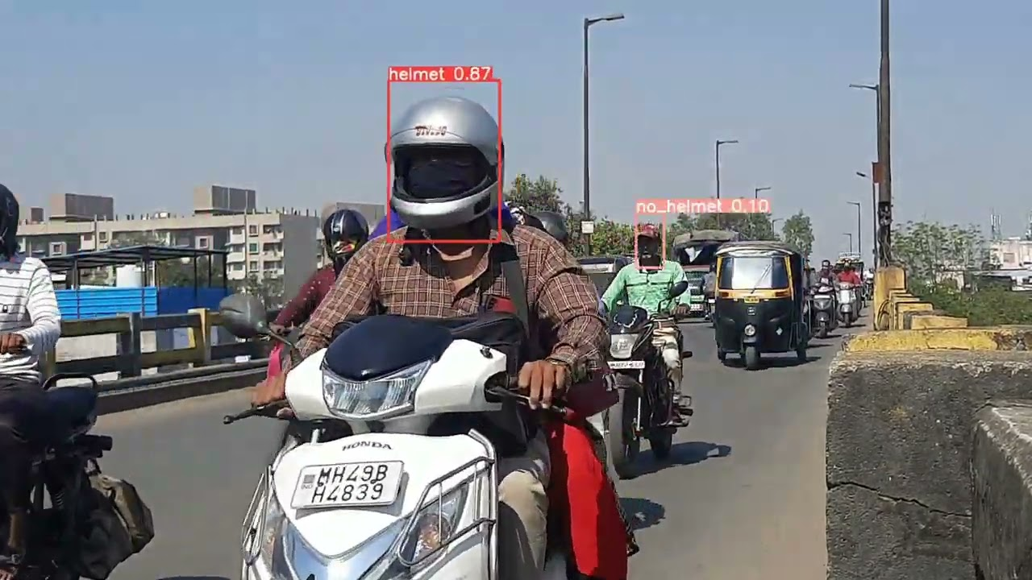
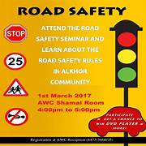
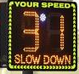
Implementation Details
Vehicle Detection: Computer vision techniques were utilized to continuously monitor the road and detect passing vehicles accurately.
Violation Detection: Overspeed, helmet, and license plate detection algorithms were employed to identify violations swiftly. To achieve accurate overspeed detection, we implemented dynamic speed limit boards. These boards dynamically set the speed limit based on traffic conditions, allowing us to swiftly identify vehicles exceeding the designated speed threshold.
Violation Flagging and Notification: Detected violations were flagged, details recorded, and authorities and vehicle owners were promptly notified via SMS or email.
AI Voice Announcement for Violations: An AI-powered voice system was implemented to announce vehicle numbers violating traffic rules, advising drivers to slow down or adhere to regulations in real-time.
Mandatory Awareness Program: It automatically sent invitations, including photos of the violation, to flagged vehicle owners, ensuring they were informed about road safety and traffic rules through mandatory online awareness programs.
Fine Payment System: A secure online platform was developed for fine payment, integrated with Stripe or PayPal, and vehicle owners were notified of fines for secure online transactions.

Slide 4

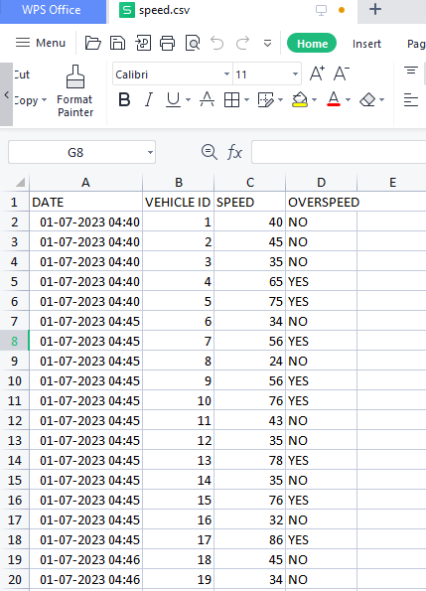
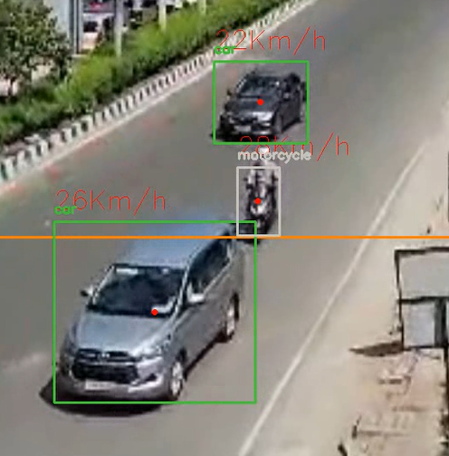
Live Demonstrations
1
Traffic Violation Detection

Slide 5

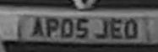

Live Demonstrations
1
Traffic Violation Detection – Number Plate Detection

Slide 6

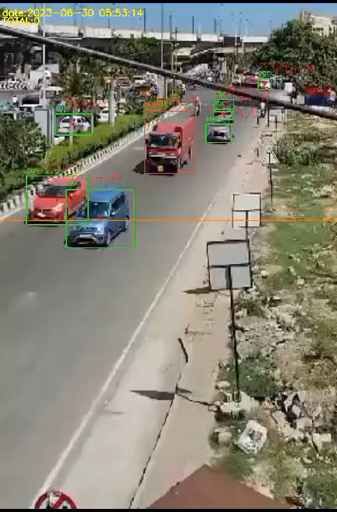
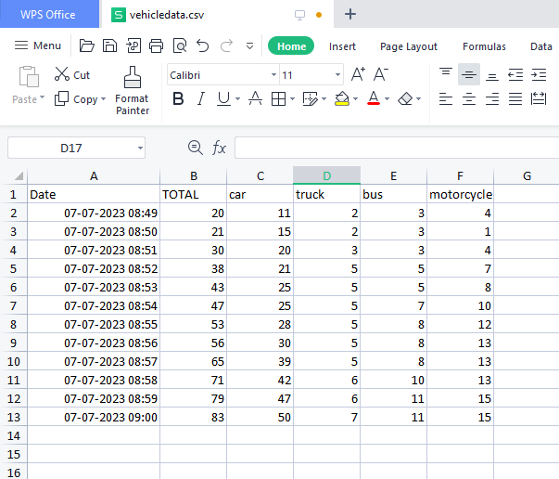
Live Demonstrations
2
AI-Analyzed Dynamic Speed Limits - Traffic Volume
@Tidel Park , Chennai

Slide 7
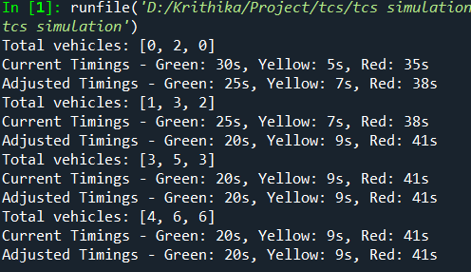
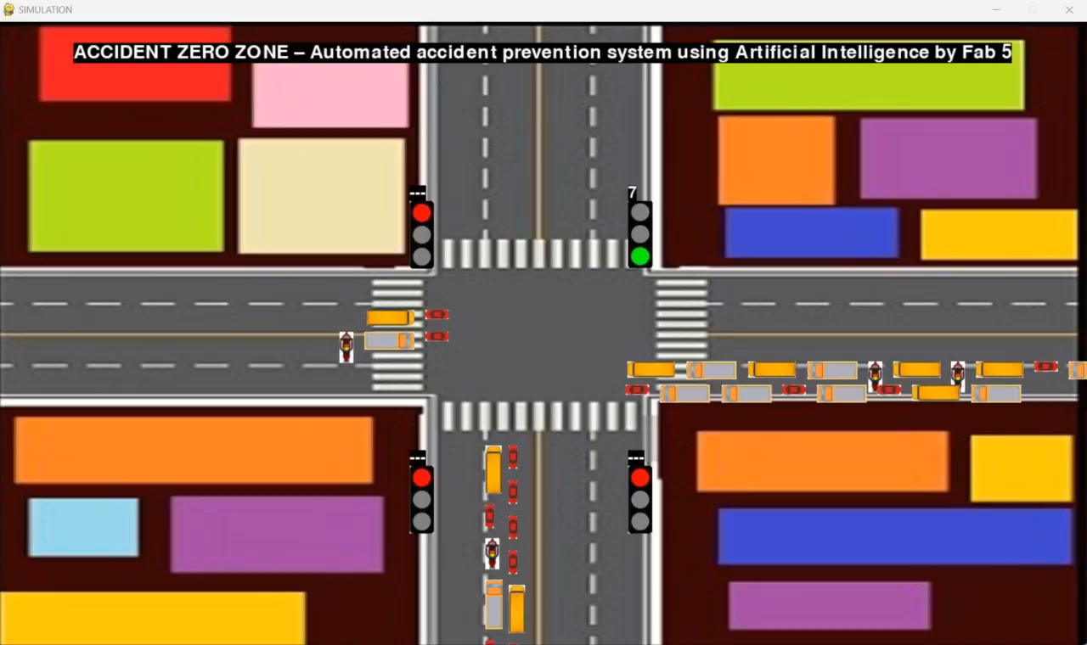
Live Demonstrations
2
Traffic Signal Timing Optimization

Slide 8

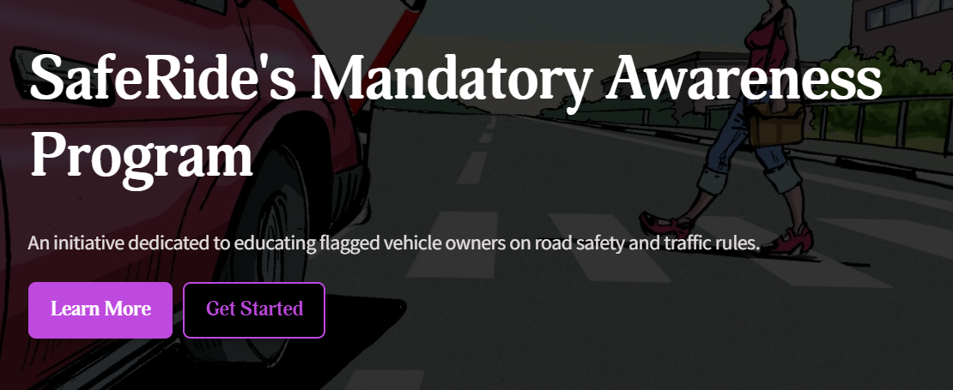

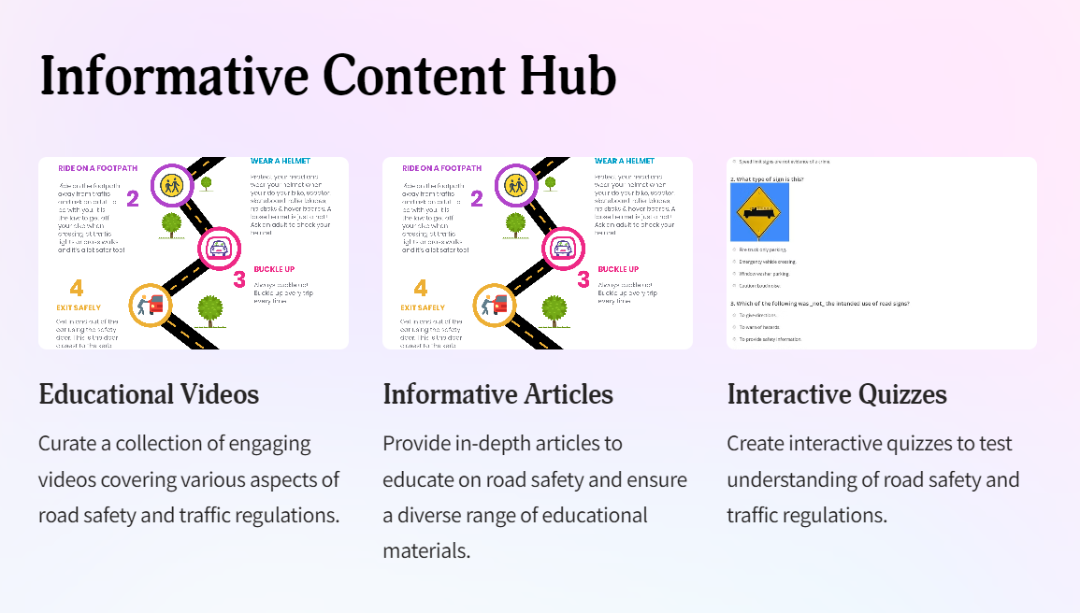
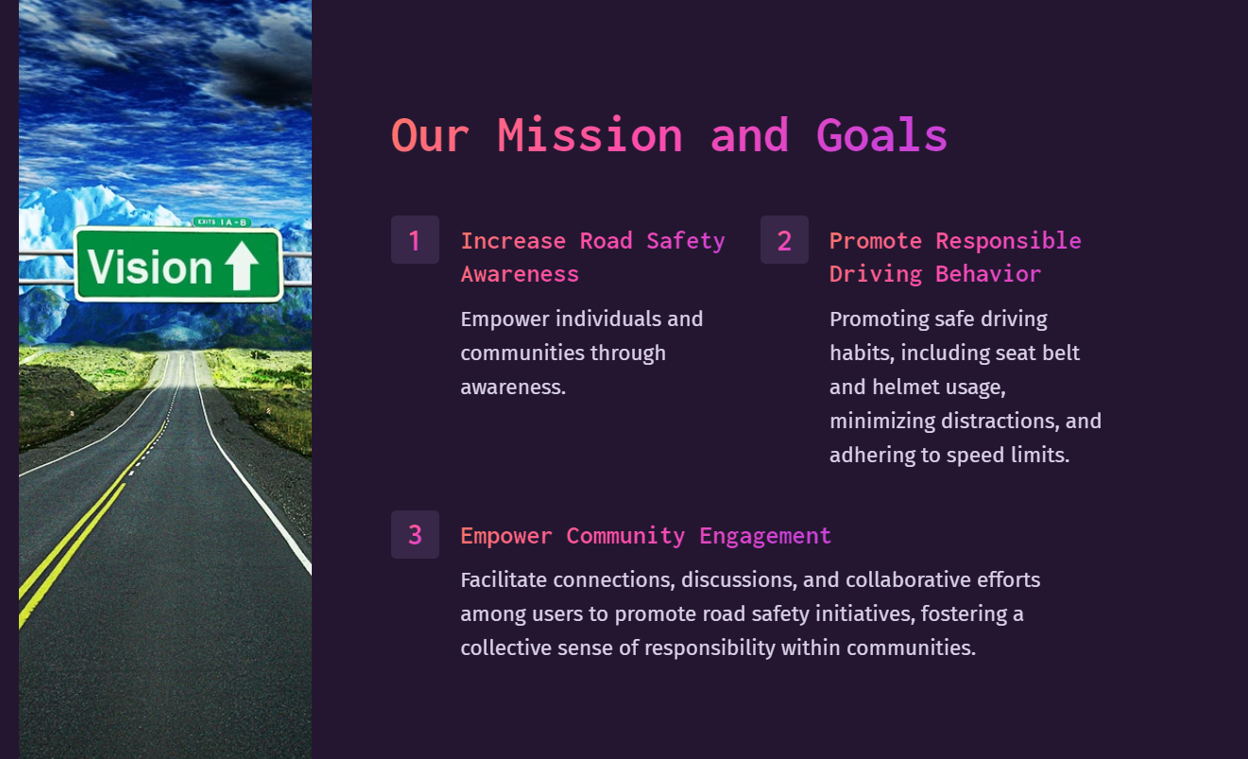
Live Demonstrations
3
Mandatory Awareness Program Interface

Slide 9
Impact Assessment
Potential Impact
Real-time Detection: Utilizes advanced computer vision to detect violations and notify authorities instantly.
Personalized Education: Tailored educational programs and fine notifications enhance driver awareness and promote compliance.
Payment Integration: Offers a secure online platform for fine payment, ensuring convenience and transparency.
Adaptive Speed Limits: Dynamically adjusts speed limits based on traffic volume, optimizing safety measures.
AI-driven Voice Alerts: AI-powered voice system delivers real-time alerts to drivers, promoting immediate adherence to traffic regulations.
1
Reduction in Road Accidents
Proactive violation detection contributes to a decrease in accidents and fatalities.
2
Traffic Flow Improvement
The implementation of adaptive speed limits and adjustments in traffic signal timings result in improved traffic flow and congestion management.
3
Enhanced Awareness
Mandatory programs promote responsible driving and increase awareness.

